Slide 1

A Project Presentation on
BEAUTY PARLOUR MANAGEMENT SYSTEM
Session 2023-2024
Guided by :
MS. JIGYASA CHANDRAKAR
(Asst. Professor)
DEPT. OF COMPUTER SCIENCE
Submitted by: SAKSHI DEWANGAN
Roll NO: 223390130042

Slide 2
Contents:
Introduction
System Analysis
System Planning
Feasibility Study
System Requirement Specification
System Design
System Testing
Input-Output Forms
Conclusion
Limitations / Future Scope
Bibliography

Slide 3
Introduction:
The "Beauty Parlour Management system" has been developed to override the problems prevailing in the practicing manual system. This software is supported to eliminate and in some cases reduce the hardships faced by this existing system. Moreover this system is designed for the particular need of the company to carry out operations in a smooth and effective manner.
The application is reduced as much as possible to avoid errors while entering the data. It also provides error message while entering invalid data. No formal knowledge is needed for the user to use this system. Thus by this all it proves it is user-friendly. Beauty Parlour Management system, as described above, can lead to error free, secure, reliable and fast management system. It can assist the user to concentrate on their other activities rather to concentrate on the record keeping. Thus it will help organization in better utilization of resources.

Slide 4
System analysis:
Existing System-
Earlier when System was not computerized. The existing system is manual based and need lot of efforts and consume enough time.
Drawback of Existing System-
Low security.
Record keeping is difficult.
Data Redundancy.
Proposed System-
The proposed system is having many advantages over the existing system.
It require less overhead and very efficient.
Advantages of Proposed System-
Simple and more user friendly.
More interactive.
It avoids time delay.

Slide 5
SYSTEM PLANNING:
Requirement Survey
Sept 18, 2023 | Oct 1, 2023
Actual Start, Sept,18 | Actual Finish, Oct 1, 2023
Requirement Specification
Requirement Specification
Oct 2, 2023 | Nov 15, 2023
Actual Start , Oct,2 | Actual Finish, Nov 15, 2023
PERT Chart-
Internal Design Specification
Dec 20, 2023 | Dec 30, 2023
Actual Start Dec 20 | Actual Finish, Dec 30, 2023
Functional Specification
Functional Specification
Nov 20, 2023 | Dec 10, 2023
Actual Start Nov 20 | Actual Finish, Dec 10, 2023
Implementation
Implementation
Jan 1, 2024 | Jan 10, 2024
Actual Start, Jan 1 | Actual Finish, Jan 10, 2024
Internal Testing
Internal Testing
Jan 12, 2024 | Jan 20, 2024
Actual Start , Jan 12 | Actual Finish, Jan 20, 2024
Documentation
Documentation
Jan 20, 2024 | Jan 30, 2024
Actual Start, Jan 20 | Actual Finish, Jan 30, 2024

Slide 6
Feasibility study:
Feasibility study includes consideration of all the possible ways to provide a solution to the given problem. The proposed solution should satisfy all the user requirements and should be flexible enough so that future changes can be easily done based on the future upcoming requirements.
The following feasibility studies are:
Economical Feasibility
Technical Feasibility
Operational Feasibility
Technical Feasibility -
For this feasibility study, we studied complete functionality to be provided in the system, as described in the System Requirement Specification (SRS), and checked if everything was possible using different type of frontend and backend.

Slide 7
System requirement specification: Minimum software & hardware requirement
Minimum Hardware Requirements
Memory: 4.00 GB RAM
Processor: Intel i3
Keyboard: Qwerty keyboard
Hard Disk: 1TB HDD
Monitor: 15-inchcolour Monitor
Network: Active Net-Connection
Minimum Software Requirements
Operating System: WINDOWS
Internet connection: Existing telephone lines, Wi-Fi.
Browser: Google Chrome or any compatible browser
Database: Sqlite3
Code Editor: VS Code Latest Version
Performance: The turn-around time the project will be medium.

Slide 8
Module description / technology description
Admin Module-
login
Dashboard
Employee
Supplier
Category
Product
Sales
Billing
Database
Front End: Python
HTML
CSS
JAVASCRIPT
Backend:
PHP
MYSQL

Slide 9
System design: Waterfall model
Feasibility Study
Requirement Gathering
Design
Coding
Testing
Maintenance

Slide 10
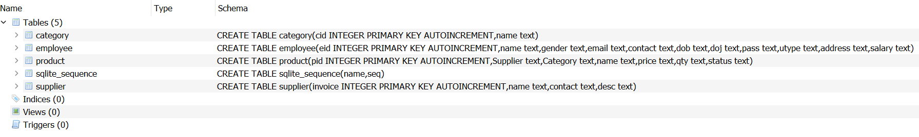
Database schema :

Slide 11
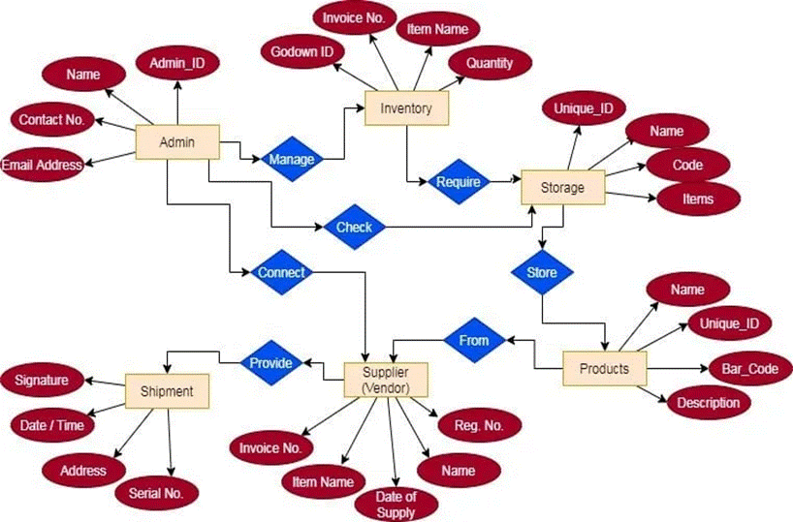
ER Diagram

Slide 12
DFD (Data Flow Diagram):
CUSTOMER
SALON MANAGEMENT SYSTEM
RECEPTIONIST
MANAGER
INVOICE DETAIL

Slide 13
System testing:
Testing is vital for the success of any software. No system design is ever perfect. Testing is also carried in two phases. First phase is during the software engineering that is during the module creation. Second phase is after the completion of software. This is system testing which verifies that the whole set of programs hanged together.
Testing is the process of detecting errors. Testing performs a very critical role for quality assurance and for ensuring the reliability of software and application.
Unit Testing: This type of testing is the testing of individual software components. It is typically done by the programmer and not by the testers. It requires details information and knowledge about the internal program design and code to perform this During unit testing, we carried out various testing task such as the reflection of the unit data on database and its interface. Various types of bugs associated with the component were identified and fixed. We use various functional keys to test our software. In our software unit testing is concerned with the stock units, opening stock units and product units validation as well as the validation of product units

Slide 14
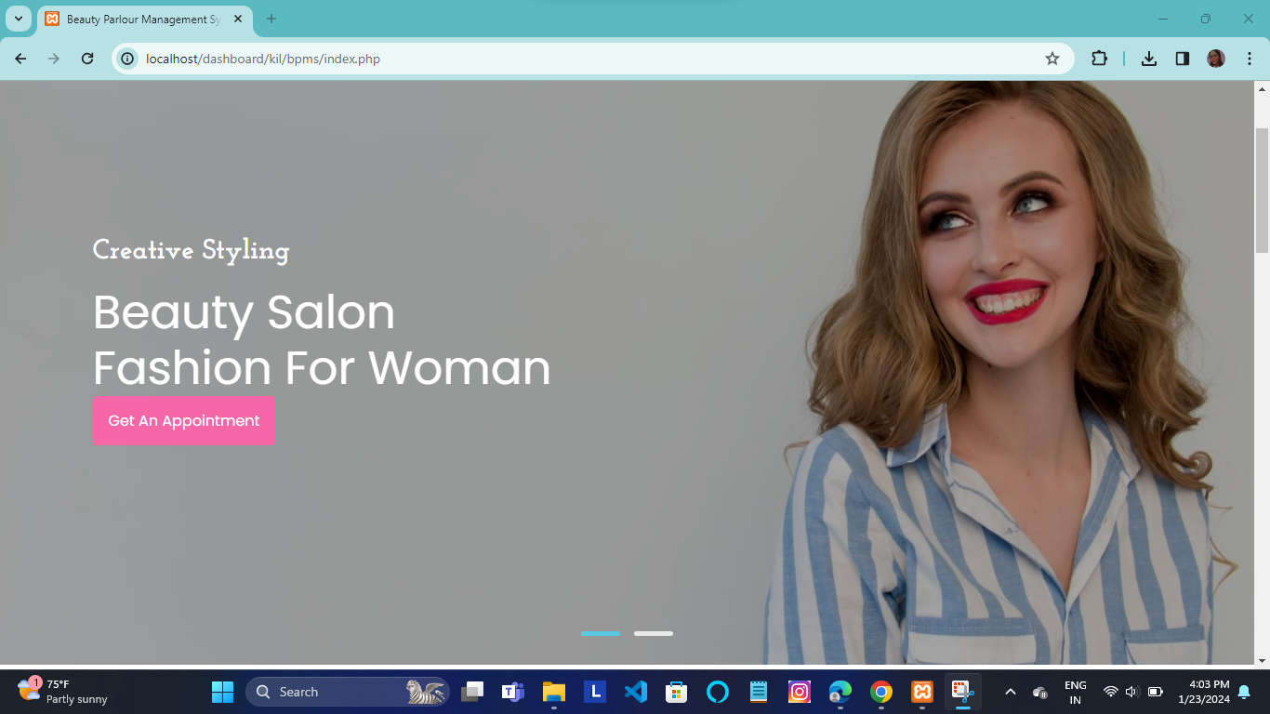
Input-output forms: HOME PAGE

Slide 15
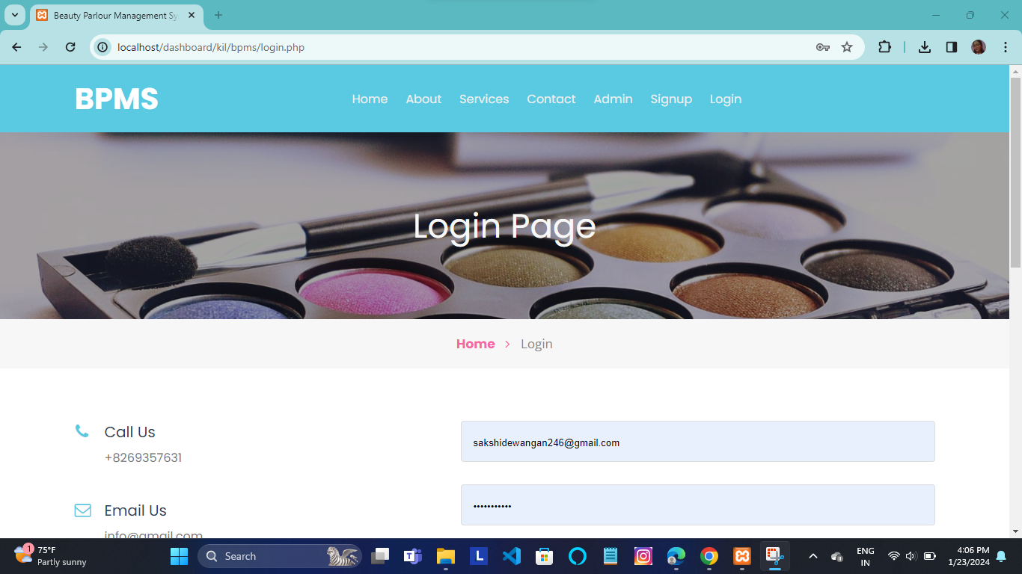
LOG IN

Slide 16
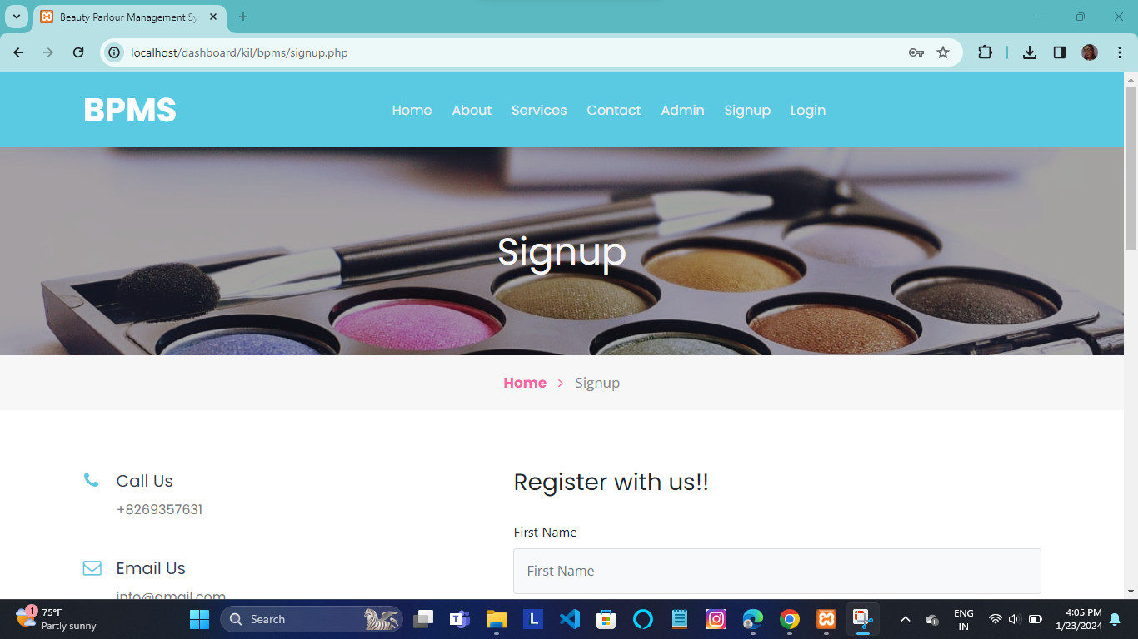
SIGNUP PAGE

Slide 17
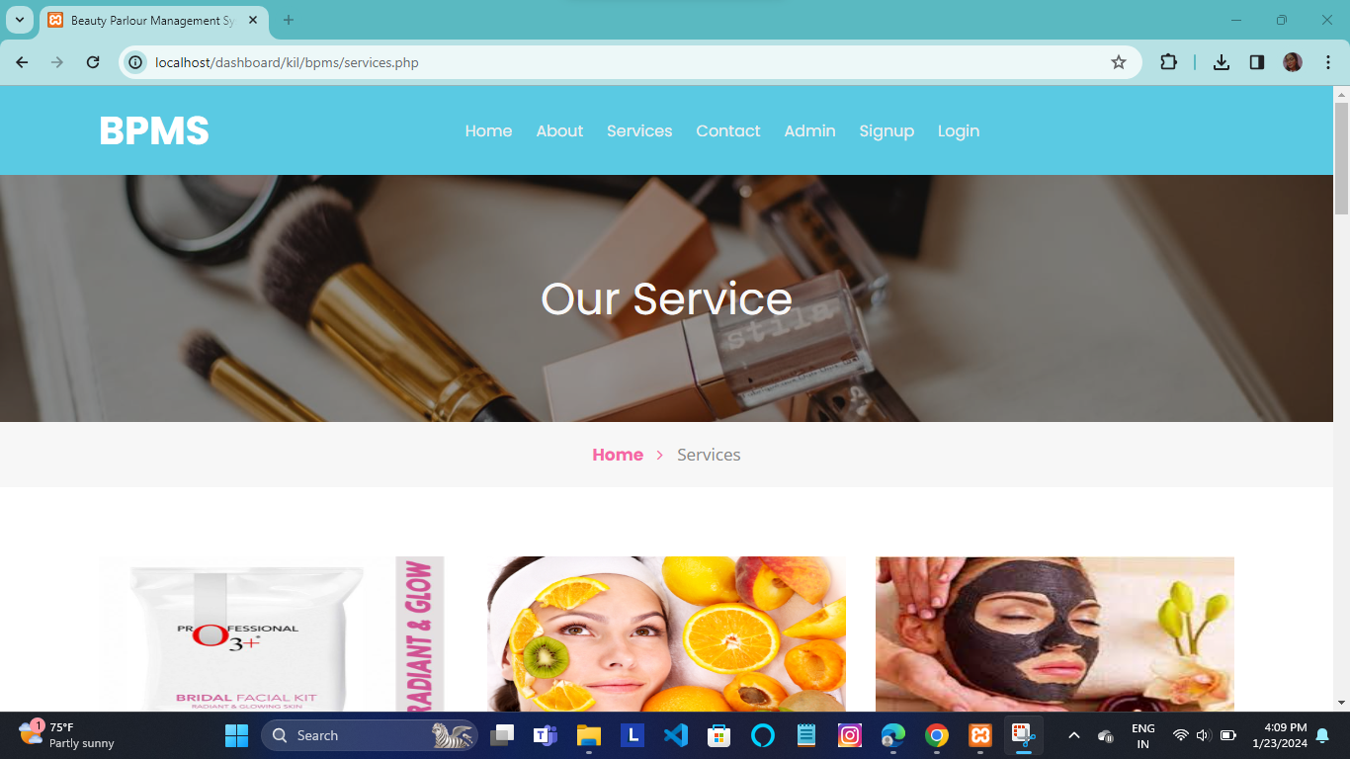
SERVICE PAGE

Slide 18
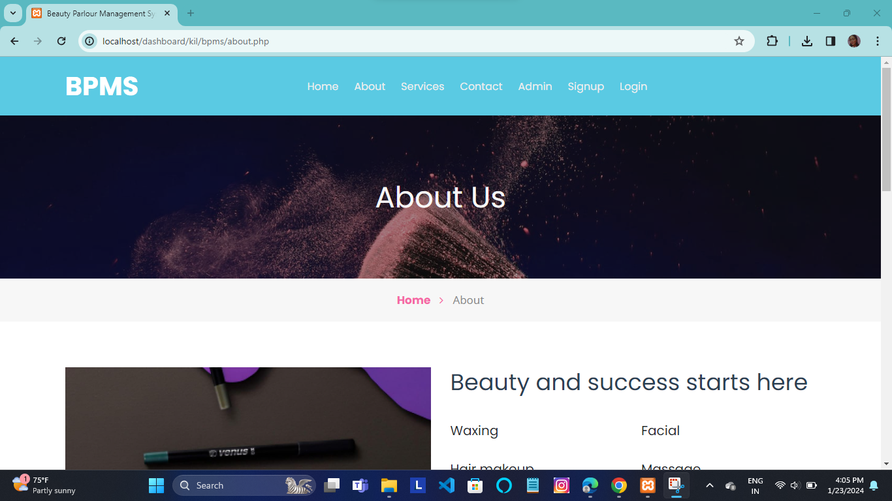
ABOUT PAGE

Slide 19
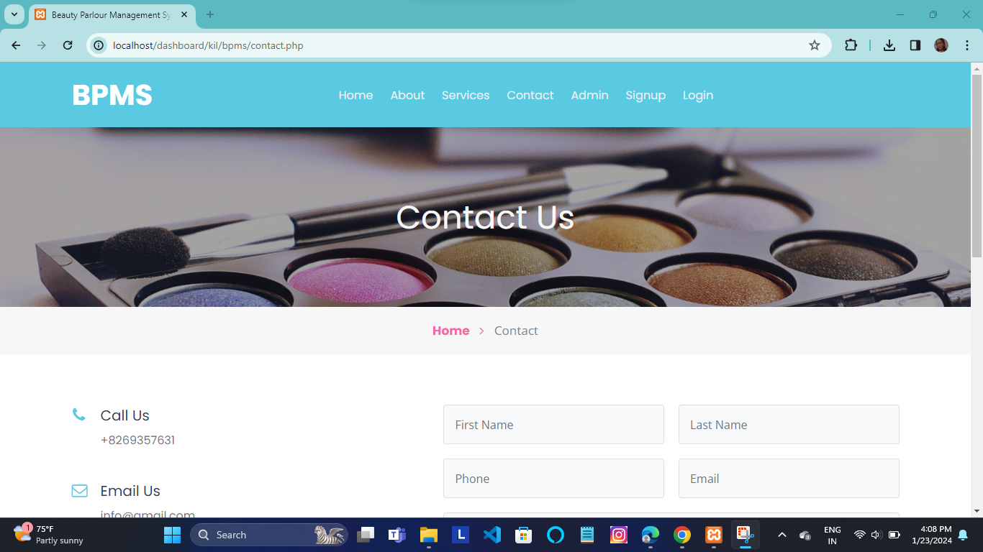
CONTACT PAGE

Slide 20
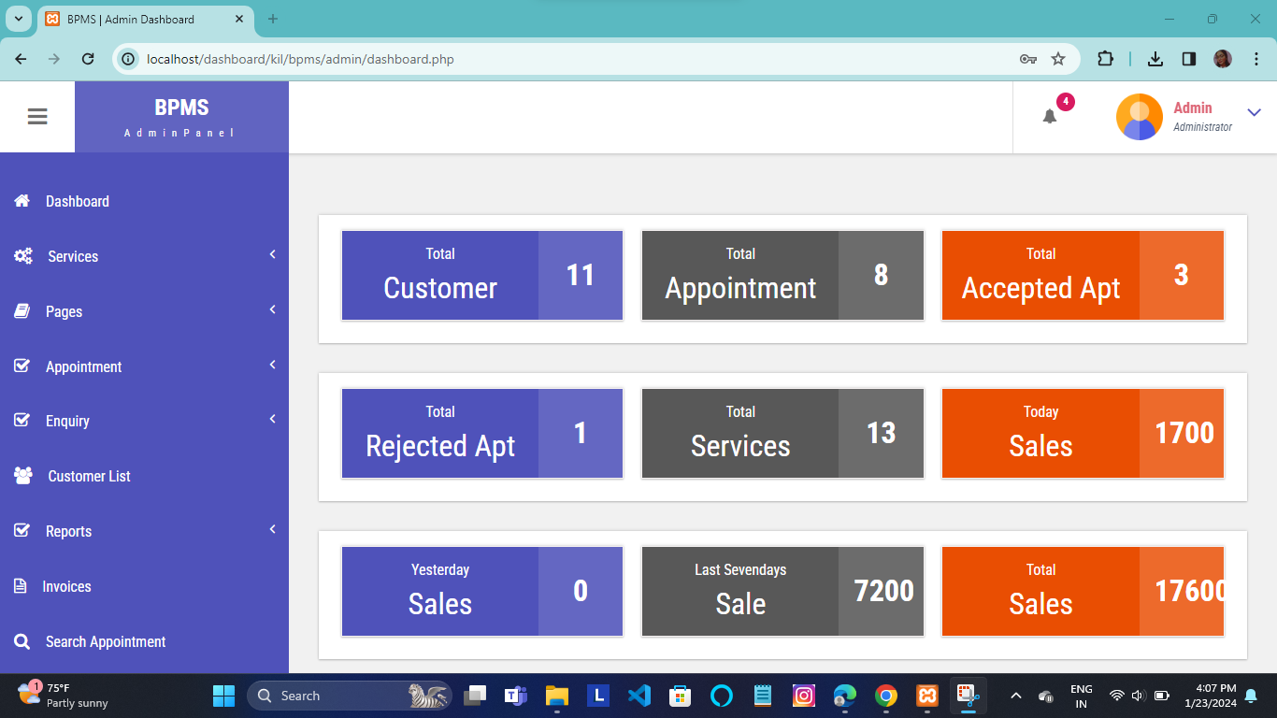
ADMIN PAGE

Slide 21
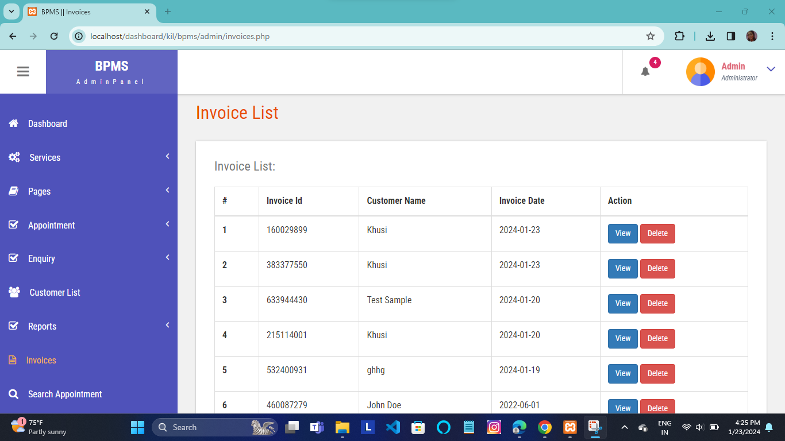
INVOICE PAGE

Slide 22
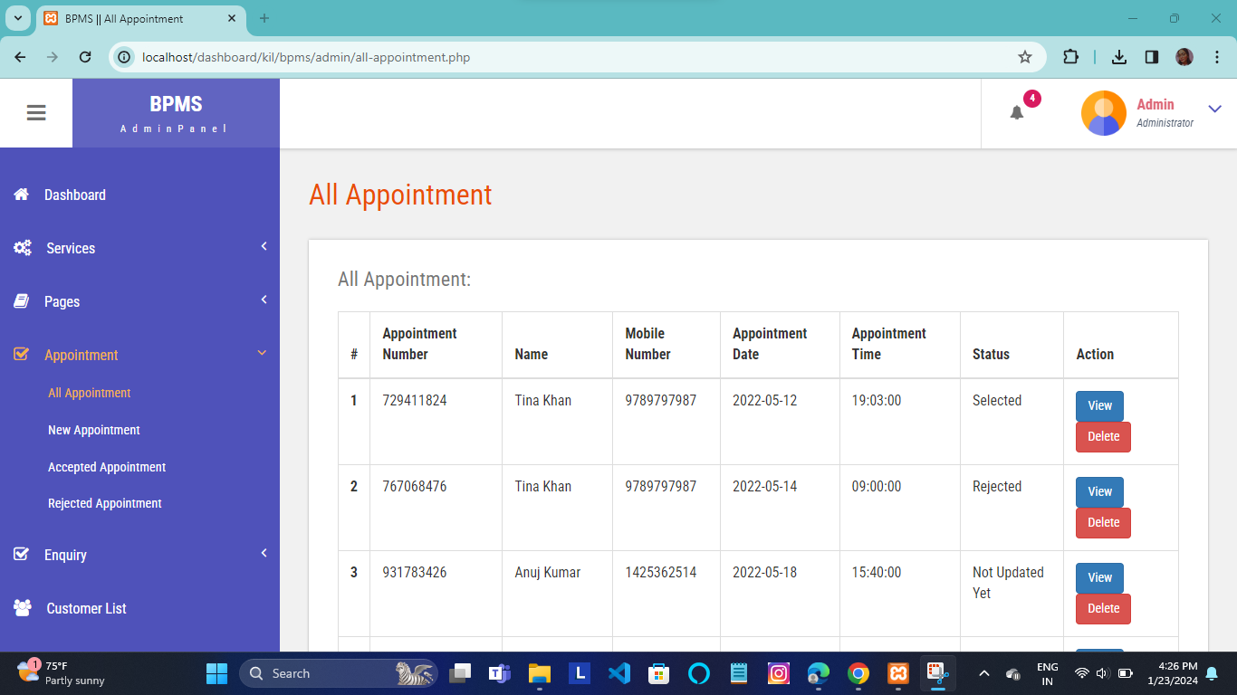
ALL APPOINTMENT PAGE

Slide 23
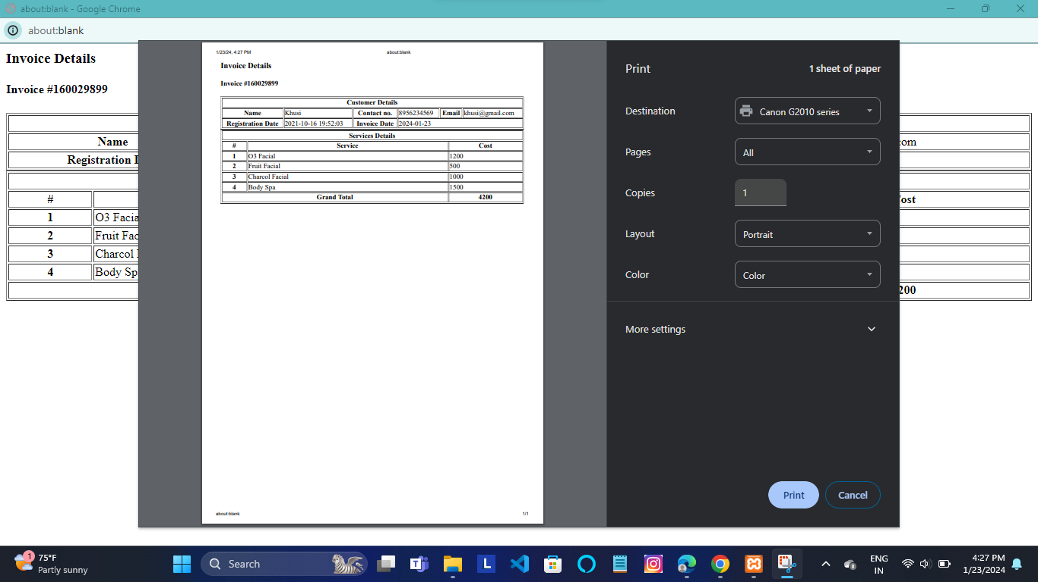
INVOICE PRINT PAGE

Slide 24
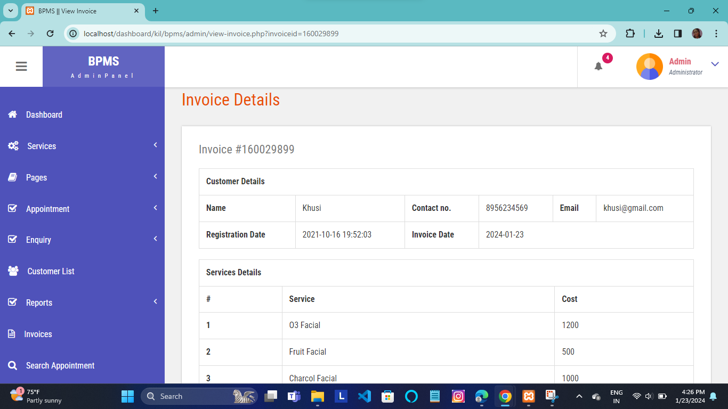
INVOICE DETAIL PAGE

Slide 25
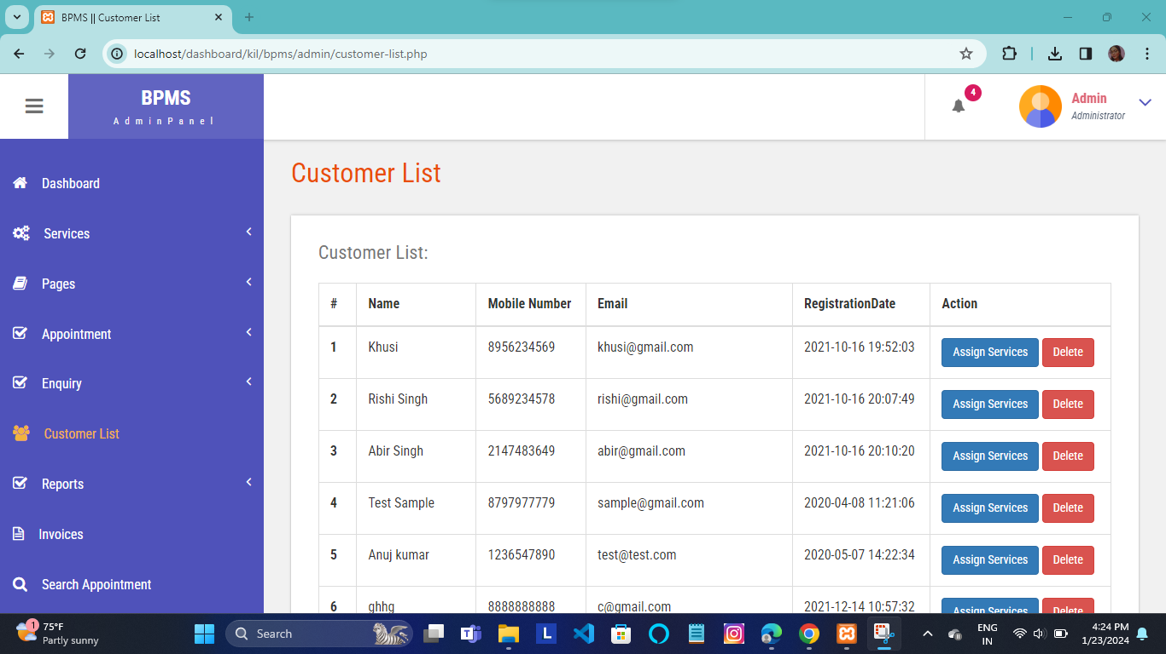
CUSTOMER LIST PAGE

Slide 26
Conclusion:
Our project is only a humble venture to satisfy the needs to manage their project work. Several user friendly coding have also adopted. The objective of software planning is to provide a frame work that enables the manger to make reasonable estimates made within a limited time frame at the beginning of the software project and should be updated regularly as the project progresses.
Made statement of the aims and objectives of the project.
The description of Purpose, Scope, and applicability.
We define the problem on which we are working in the project.
We included features and operations in detail, including scree layouts.
We designed user interface and security issues related to system.

Slide 27
Limitations / future scope:
Limitations-
It is not a large-scale system.
Only limited information provided by the application.
Excel export has not been developed for Stock, Inventory due to some criticality.
The transactions are executed in off-line mode, hence on-line data for Products, Sells capture and modification is not possible.
Future Scope-
This application can be easily implemented under various situations.
We can add new features as and when require.
Reusability is possible as and when required in this application.
There is flexibility in all the modules.
Payment form will be filled online in future.

Slide 28
Bibliography:
Web References –
https://www.w3schools.com
https://www.javapoint.com
https://www.greeksforgeeks.org
https://www.javapoint.com/Mysql-tutorial
https://www.tutorialspoint.com

Slide 29
Thank you

